Slide 1
DL Problem 1
Kai Chong, Cheng Jhang, Jeren, Vincent, Dominic

Slide 2
Problem and Approach
Classify reviews from 1 to 5 stars
Data from app reviews on Google Play Store
Aim is to optimize validation accuracy of models
Universal workflow of machine learning

Slide 3
Data collection and Processing

Slide 4
Data Collection
Each member selected an app on Google Play Store
Scraped 40000 reviews from the reviews
Ranked the quality of data retrieved
Metrics such as average age of app users
Suggests reliability and maturity of reviews

Slide 5
App rankings
1. Facebook --> Excelling Quality
2. Instagram --> High Quality
3. Snapchat --> Moderate Quality
4. Disney+ --> Low Quality
5. Temple Run --> Poor Quality

Slide 6
Data Processing
Used to clean and manipulate data
Optimize data for model training
Reduce noise during training
Convert reviews into a form understood by the model (vectorization)
"Garbage in, garbage out" Importance of good quality data

Slide 7
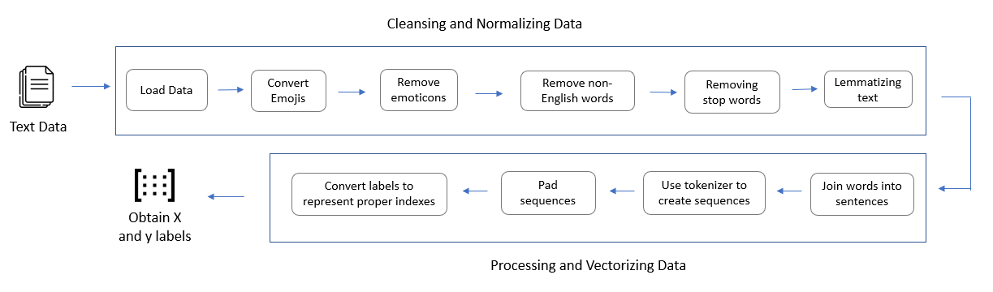

Slide 8
Dominic - Snapchat Model
Individual Training

Slide 9
Tuning Steps
1. Model architecture
2. Model parameters
3. Combat overfitting

Slide 10
Hyperparameters Tuned
LSTM vs GRU vs Simple RNN
Number of RNN layers & neurons in each layer
Number of Dense layers & neurons in each layer
Optimizers
Learning Rate
Activation Function
Dropout
Regularizers
Weight Normalization

Slide 11
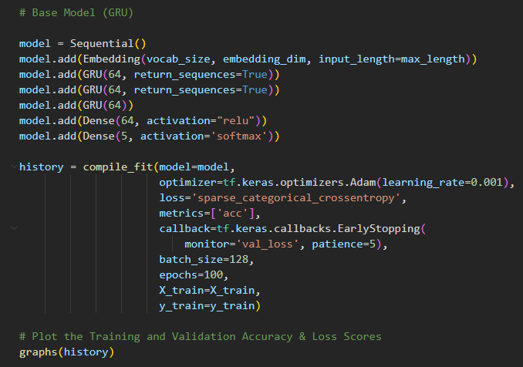
Baseline model code

Slide 12


Training Summary

Slide 13
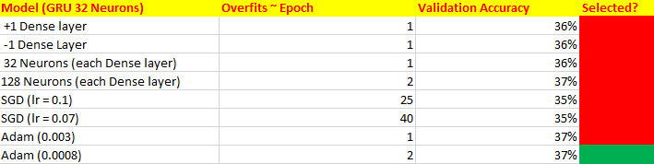
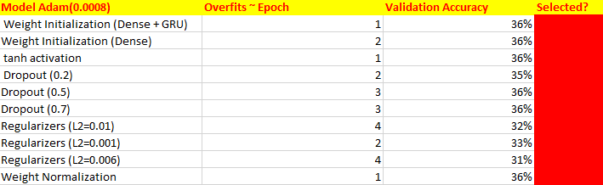
Training Summary

Slide 14
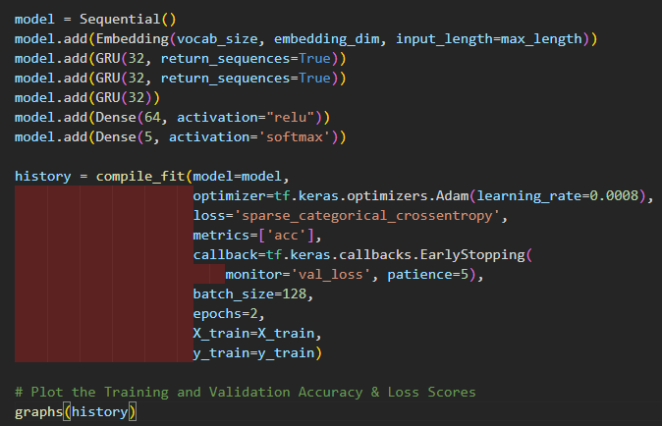
Final Model Code

Slide 15
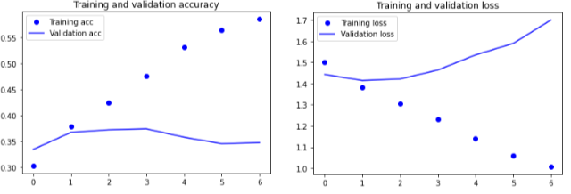
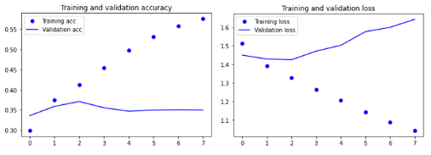
Initial
Both models reached validation accuracies of 37%
Both also starts to overfit at epoch 2
Little to no improvement in accuracy
Low quality of data, insufficient testing, lack of data
Final

Slide 16
Kai Chong – Disney+ Model
Individual Training

Slide 17
Architectures to consider:
GRU Network and LSTM Network
RNN variants known to resolve the issue of a vanishing gradient
Internal mechanisms called gates that help regulate the flow of temporal information
Since both are effective, the baseline model will be compared for both architectures and the better performing model will be the architecture that will be explored in greater depth
Notes:
Firstly, I compared two architectures namely GRU and LSTM which have been known to efficiently process temporal data. To elaborate, GRU and LSTM are RNN variants that are known to resolve the issue of a vanishing gradient. This is done by leveraging internal mechanisms called gates that help regulate the flow of temporal information. Since both architectures are effective, the baseline model will be compared for both architectures and the better performing model will be the architecture that will be explored in greater depth.

Slide 18
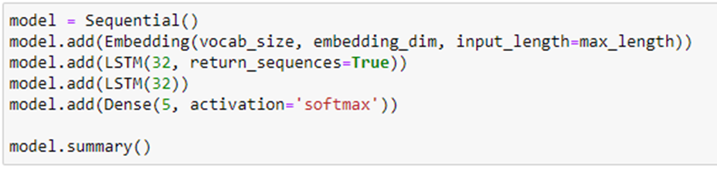
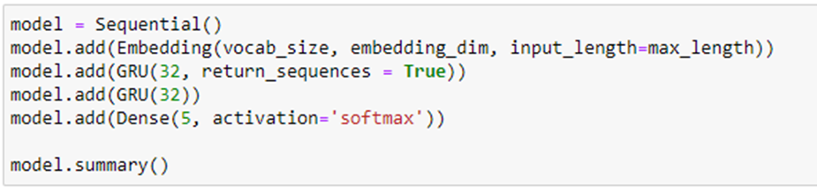
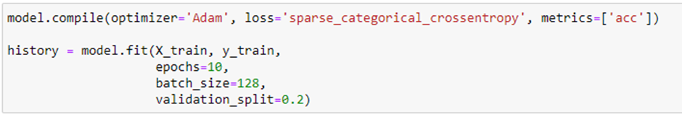
Baseline models
Notes:
The baseline models consists of 2 recurrent layers each with 32 recurrent units. The embedding layer is added before the recurrent layers for dense vector representations. Since this is a five-class classification problem, the output classifier has 5 nodes, and the softmax nonlinear activation function is used. The models are utilized with the Adam optimizer, and since the data is encoded as integers, sparse categorical crossentropy is the loss function used.

Slide 19
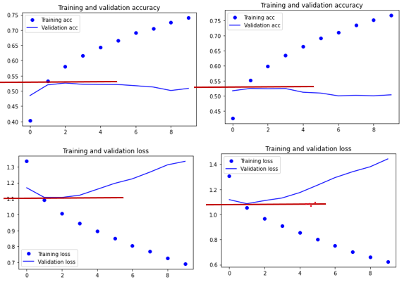
LSTM vs GRU
LSTM (Left); GRU (Right)
The results are roughly the same, however, the GRU model has slightly lower loss values
As such, we will aim to improve on the GRU baseline model for this problem
Notes:
With that being said, the LSTM and GRU baseline models were built and compared. In the above image, the LSTM results are on the left, and the GRU results are on the right. From the image, we can see that the results are roughly the same, however, the GRU models has slightly lower loss values giving it the edge. As such, we will aim to improve on the GRU baseline model for this problem.

Slide 20
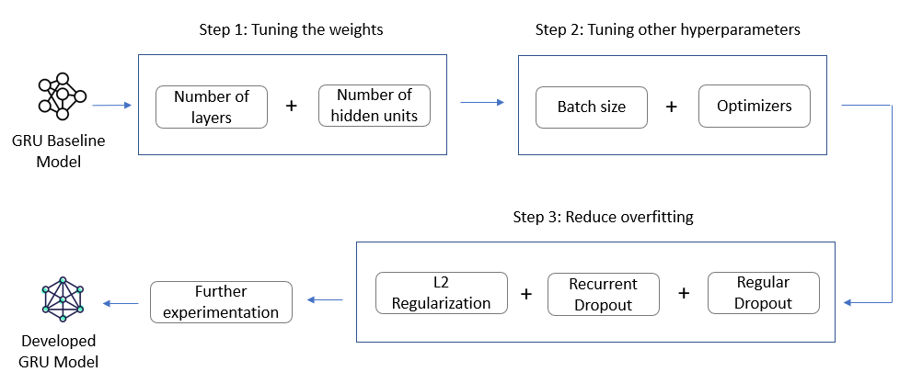
Notes:
To improve on the baseline model, a systematic approach following the universal machine learning workflow was used. Firstly, we tune the weights with the aim of improving the model accuracy. Next, we tune other important hyperparameters like the batch size and optimization algorithms, and lastly, we aim to reduce overfitting, by testing a combination of overfitting techniques namely L2 regularization, recurrent dropout and regular dropout.

Slide 21
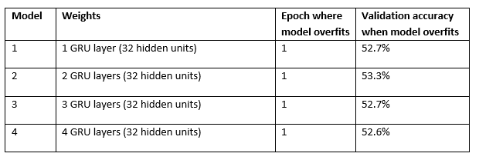
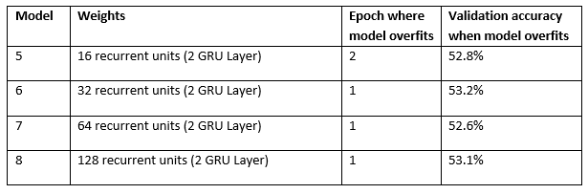
STEP 1: Tuning hidden layers and weights
Hyperparameters tested: recurrent layers (1-3) & recurrent units (16-128)
Best set of weights: 2 GRU layers with 32 nodes each
Notes:
As mentioned, we first start by tuning the hidden layers and the weights. In this step we experimented with the recurrent layers from 1-3 layers, and recurrent units ranging from 16-128 hidden units. For each hyperparameter experimentation, the results were recorded and stored in summary tables for better insight. After experimentation, we deduce that the best set of weights are 2 GRU layers with 32 nodes each

Slide 22
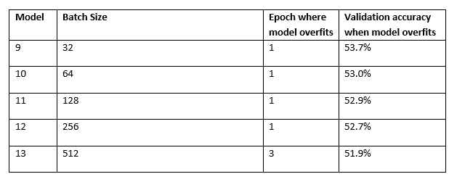
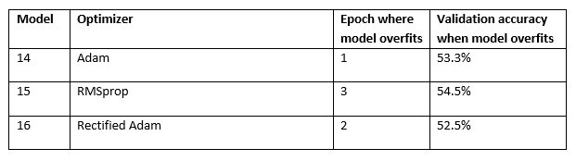
STEP 2: Tuning batch sizes and optimization algorithms
Batch sizes: 32 to 512
Optimization algorithms: Adam, RMSprop and Rectified Adam
Notes:
Moving on, we tune the batch sizes and optimization algorithms. In this step, batch sizes were tested from a range of 32-512. 3 Optimizers were tested, namely Adam, RMSprop and Rectified Adam, which is a variant of the Adam optimizer that aims to resolve variance and generalization issues. From the results, we see that a batch size of 32 performed the best, and the RMSprop optimizer achieved the highest validation accuracy

Slide 23
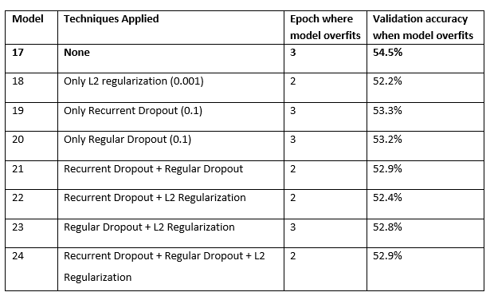
STEP 3:Reduce overfitting
Hyperparameters tested: L2 Regularization, recurrent dropout and regular dropout
Best combination of techniques: None
Notes:
Next, we proceed to test techniques with the aim of reducing overfitting. The techniques tested were L2 regularization at a value of 0.001, regular dropout and recurrent dropout at percentages of 10% From the table, we deduce that in this case, none of the techniques were able to help the model overfit later, and always resulted in a drop in accuracy.

Slide 24
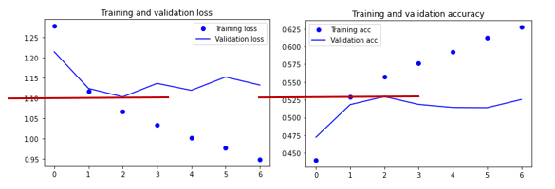
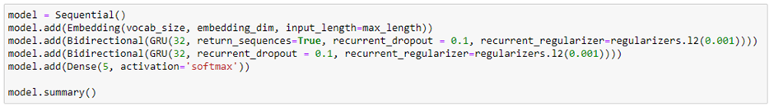
Step 4: Experimentation – Bidirectional GRUs
- Lastly, the GRU layers in the final GRU model were replaced with Bidirectional GRU layers to see if the implementation of Bidirectional traversal helped the model to learn better
- However, upon analyzing the model performance, the model accuracy did not improve, suggesting that adding Bidirectionality in the model in this case was not necessary
Notes:
Lastly, the GRU layers in the final GRU model were replaced with Bidirectional GRU layers to see if the implemetation of Bidrectional Traversal helped the model to learn better. However, upon analyzing the model performance, the model accuracy did not improve suggesting that this was not a necessary addition

Slide 25
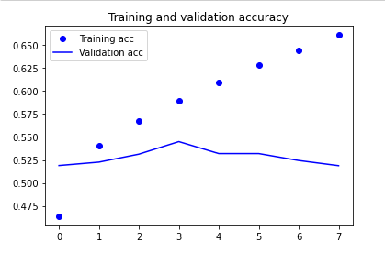
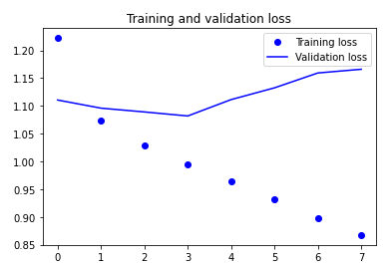
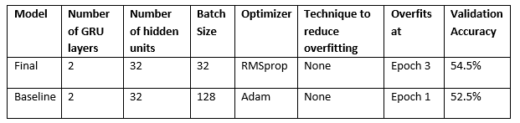
Final GRU Model performance:
Final GRU model
Accuracy increased from 52.5% to 54.5%
Model overfit later at epoch 3
Weights were kept the same but Optimizer and Batch size changed from 128 to 32 and RMSprop to Adam
Final vs Baseline GRU model comparison table:
Notes:
With that being said, this is the final GRU model obtained. From the performance curves and summary table, we can see that the validation accuracy has increased from 52.5% to 54.5%. The improved model was also able to overfit slightly later at epoch 3. In terms of hyperparameters, the weights remained the same, but the optimizers and batch size were change from RMSprop to Adam, and 128 to 32 respectively.

Slide 26
Jeren – Instagram Model
Individual Training

Slide 27
Hyperparameters tuned
GRU vs LSTM
Dropout
Batch size
Dense Layers

Slide 28
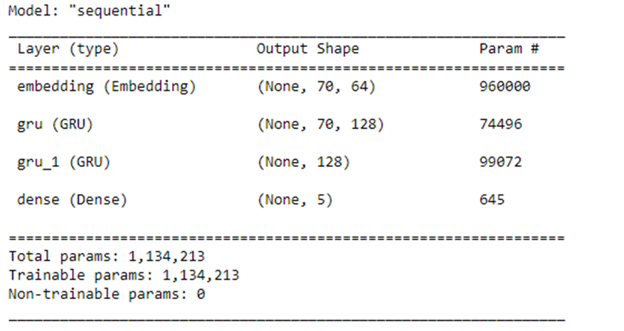
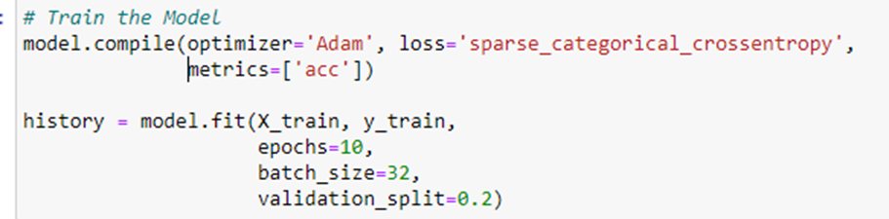
Baseline model

Slide 29

Training Summary

Slide 30


Training Summary

Slide 31
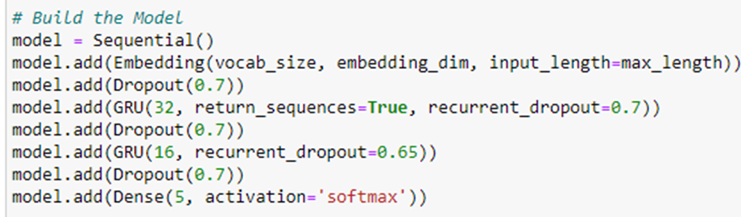
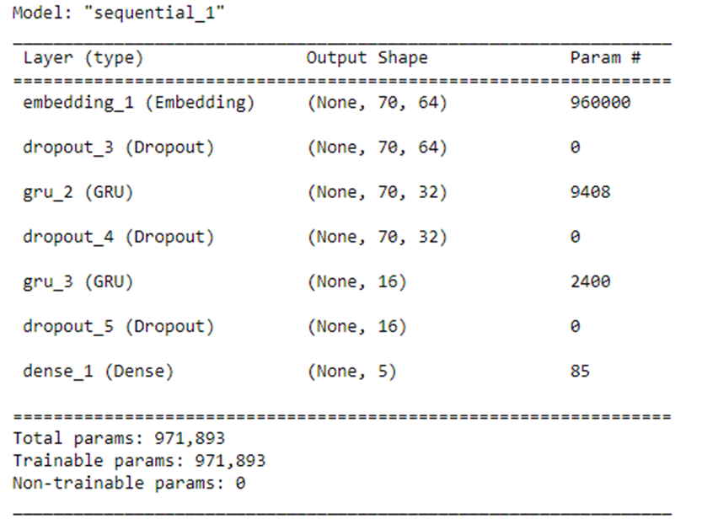
Final model

Slide 32
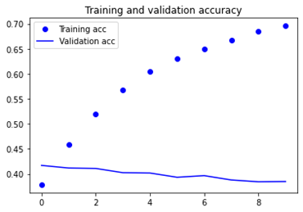
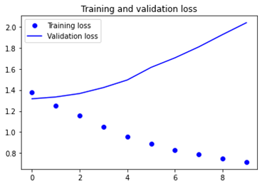
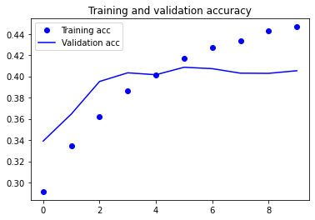
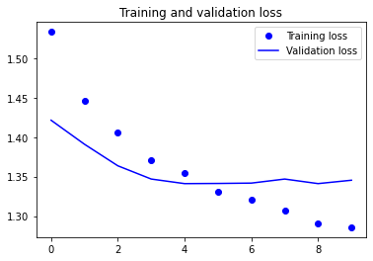
Initial
By reducing the amount of neurons in each layer, we are able to reduce the number of overfitting
Accuracy is improving from the initial 38% to a final accuracy of 40%
Accuracy is still low due to low quality data
Final

Slide 33
Vincent – Facebook Model
Individual Training

Slide 34
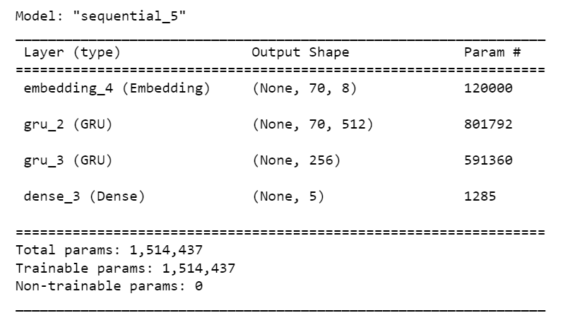
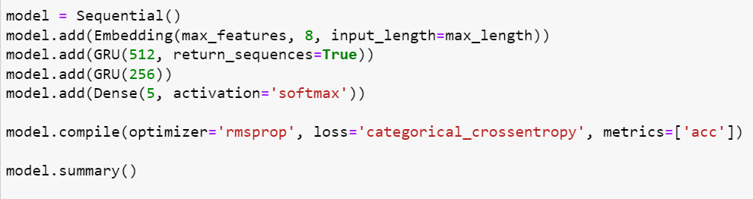
Baseline Model

Slide 35
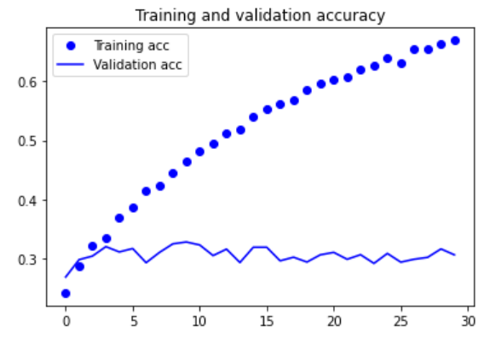
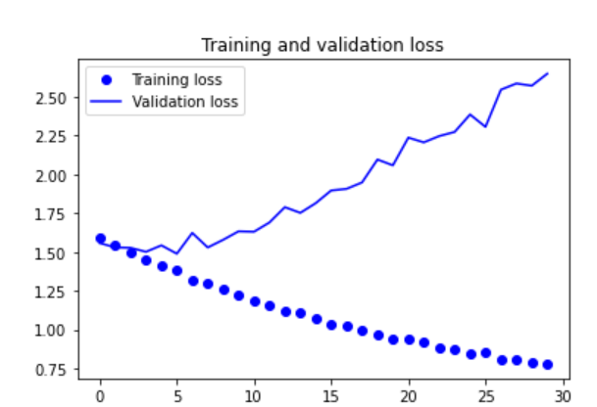
Model accuracy

Slide 36
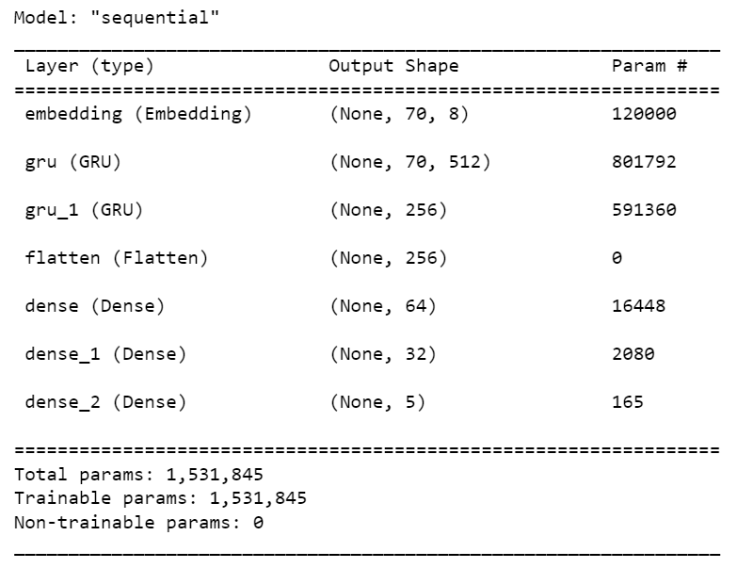
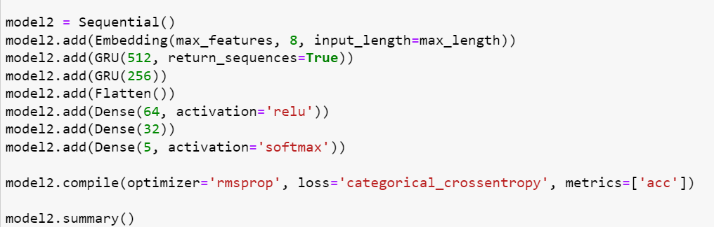
Model 2

Slide 37
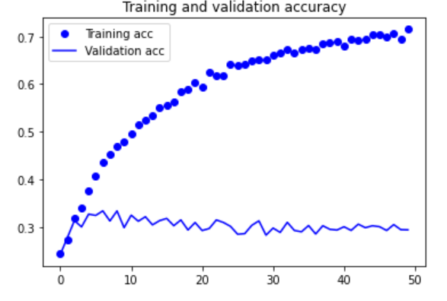
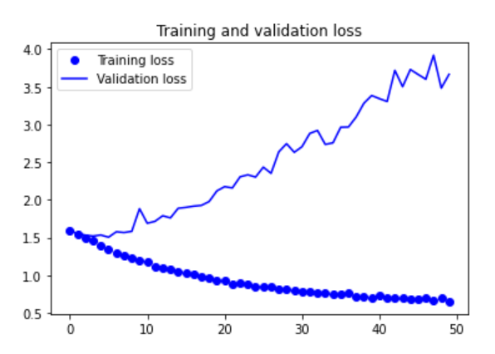
Model Accuracy

Slide 38
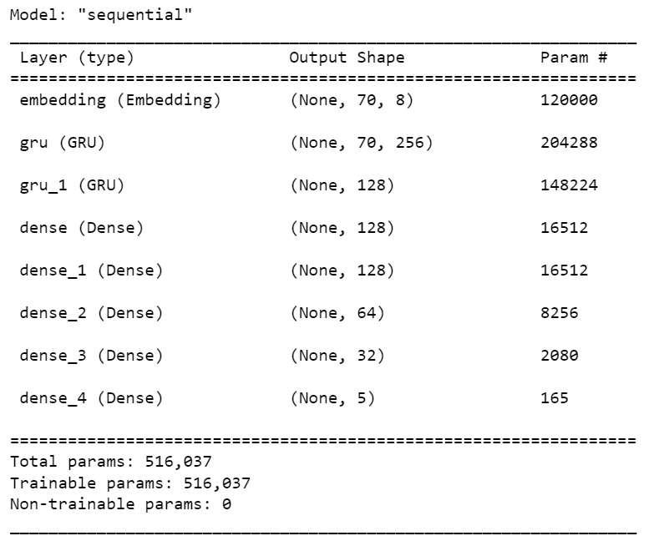
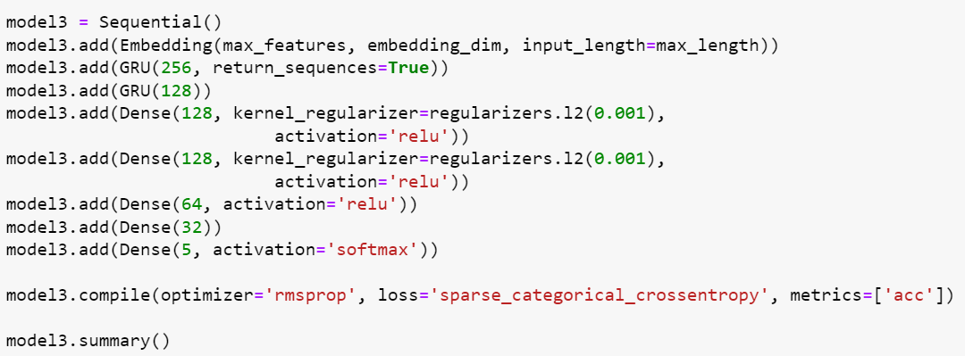
Final Model

Slide 39
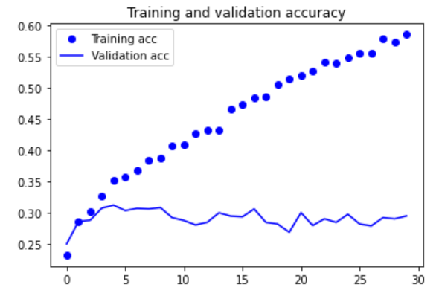
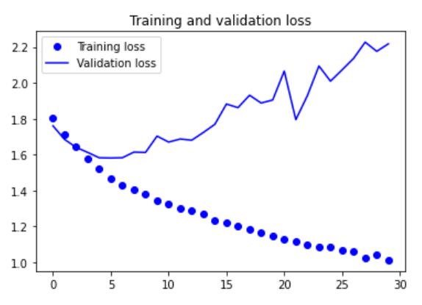
Final Accuracy

Slide 40
Cheng Jhang – Temple Run Model
Individual Training

Slide 41
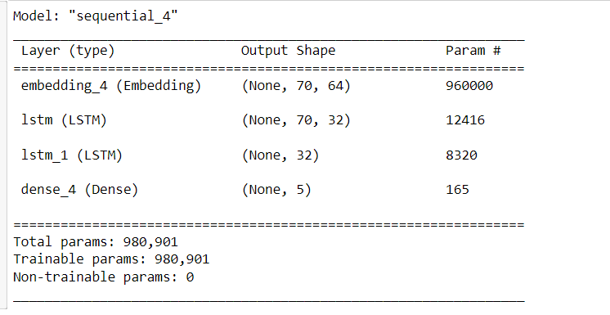
Baseline Model
Compilation of model
Optimizer: RMSprop
Epochs: 10
Batch size: 128
Validation split = 0.2
Notes:
For the very first run of my model, it will be a Long Short-Term memory (LSTM) model. In this model, the first layer will be the embedding layer where sentences will be represented as max_length by embedding_dim vectors. The next two layers LSTM layers with 32 as its parameter, with one of them utilizing the “return_sequences” argument which determines whether to return the last output in the output sentence, or the full sequence. Finally, ending it off with a dense layer with 5 as its parameter and for the activation function, I will be using the ‘softmax’ activation function because we are currently dealing with a multiclass logistic regression type of problem so it would not make sense to use ‘sigmoid’ as it is usually used for two-class logistic regression problems.
I compiled my model with the RMSprop optimizer which is an extension of gradient descent. Since I ended the network with a softmax unit, which results in me using sparse categorical cross entropy as our loss. The reason why I chose sparse categorical cross entropy over categorical cross entropy is because it saves time in memory as well as computation because it simply uses a single integer for a class, rather than a whole vector. When it came to fitting the model, I decided to run it for 10 epochs to roughly gauge the performance of the model and went with a batch size of 128.

Slide 42
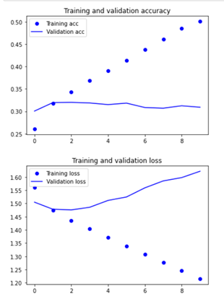
Model Accuracy
Notes:
We can see here that the validation accuracy started with an accuracy of 30% to which it increased slightly to 32% meeting the second epoch and from that point onwards, it just stayed consistent throughout without experiencing any drastic changes.

Slide 43
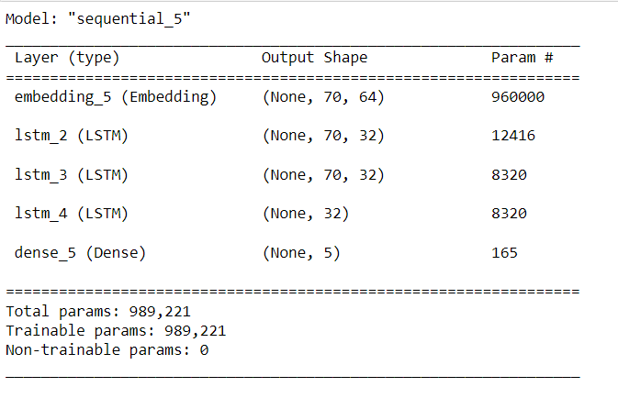
Tuning the Model
Compilation of model
Optimizer: RMSprop
Epochs: 10
Batch size: 128
Validation split = 0.2
Notes:
During the second run, I decided to add one more layer to the LSTM model in hopes of increasing the “depth” of the neural network. Since LSTMs work with sequence data, the addition of layers over time provides levels of abstraction to the input observations. I can decrease the number of units in each layer by adding additional levels, resulting in a higher "depth" rather than "width." Hence, I added one more LSTM layer consisting of the “return_sequences” argument again as well as with a recurrent dropout of 0.5. Hopefully, with the recurrent dropout there, it can help improve the performance and generalization power of the recurrent network. It also helps in regularization of the recurrent neural network. There were no changes made to the compilation and fitting of the model.

Slide 44
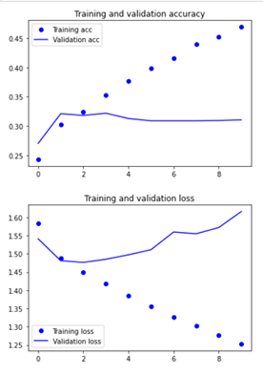
Model Accuracy
Notes:
We can see here that the validation accuracy started at an accuracy of 27% this time and increased to 32% after which it stayed the same throughout the graph. The difference this time compared to the previous graph is that the validation accuracy was able to meet the third epoch compared to the previous time where it could only reach the second.

Slide 45
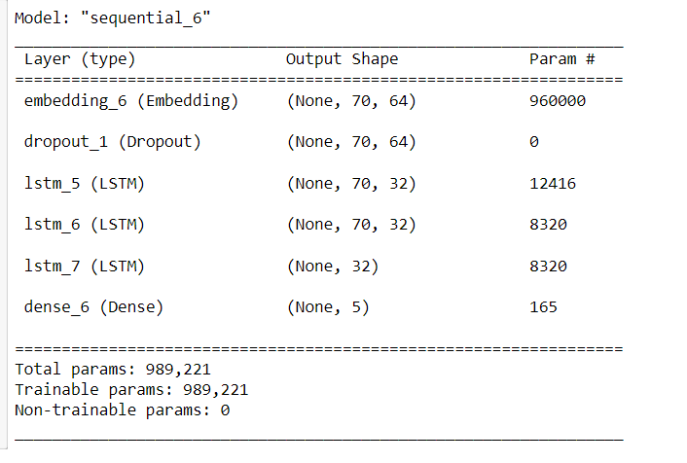
Tuning the Model
Compilation of model
Optimizer: RMSprop
Epochs: 10
Batch size: 128
Validation split = 0.2
Notes:
For the third run, I decided to add a dropout layer of 0.5 first and recurrent dropouts of 0.5 as well to the LSTM layers . This is done in hopes of being able to bring the training and validation accuracy closer to each other which in return would help improve the performance of the model.

Slide 46
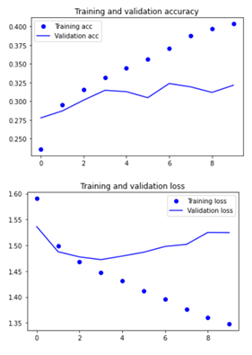
Model Accuracy
Notes:
From the training and validation accuracy graph, we can see that gap between the validation and training accuracy line has lessened after the implementation of the dropout layer which is good because it shows that the evaluation of the training data is getting like the evaluation, we care about most. The validation accuracy, however, did not increase and stayed around the 30-32% range.

Slide 47
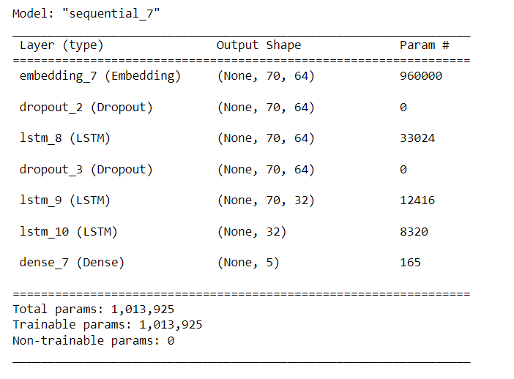
Tuned Model
Compilation of model
Optimizer: RMSprop
Epochs: 10
Batch size: 128
Validation split = 0.2
Notes:
After analysing the results from the previous model, I decided to add one more dropout layer of 0.6 this time before the first LSTM layer of the model. I changed the output units of the first LSTM layer as well from 32 to 64 which in return did give me better results.

Slide 48
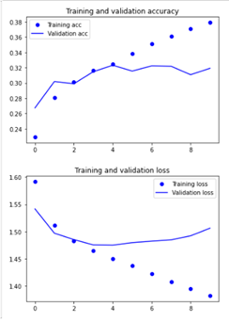
Model Accuracy
Notes:
We can see from this graph that the validation accuracy even though still lingering at around 32% only has finally matched the training accuracy at the third, fourth and fifth epoch before straying away from it again. This shows that adding the dropout and recurrent dropout layers did help with the fitting of the graph but only to a certain extent. After having ran numerous runs, I have concluded that with the quality of data provided, the highest the validation accuracy can go is only 32% so choosing this model as the best model is not recommended.

Slide 49
Model Evaluation
Notes:
After we developed all our models, we proceeded to evaluate our models.

Slide 50
Model Evaluation using Testing Data
Evaluation models based on testing data
Find out the best model
Every model was trained using a different word index mapping
Need to use model's Tokenizer text_to_sequence on the test data to have ensure the same mapping
Same random state to ensure test sets were the same for a dataset
Model evaluates all 5 test datasets (including its own test ds)
Notes:
This process was done using all 5 testing datasets, with to aim of finding the best model to be used to perform sentiment analysis. Since each of the datasets used to train each model are encoded with different word indexes, we first standardized each dataset for consistency before testing the models so that the accuracies could be the best estimate of the model's performance. Therefore, to standardize the datasets, we encoded each dataset with the tokenizer text to sequence function to consistently map each word to their index. Random state was also used to ensure the test sets were the same samples, and once that is done, each model evaluates all 5 test datasets.

Slide 51


Evaluation of Results
Accuracy across all datasets
Average accuracy
Notes:
Next, we plotted summary tables to record model performances. One notable insight was that the models trained using the testing dataset of their corresponding app performed the best in conjunction with their own testing datasets. For example, the Disney+ model which was trained with the Disney+ dataset performed exceptionally well with its test dataset in comparison to other test datasets. Using the overall average accuracy as our performance metric, our team was able to rank each model in terms of their performance. From the figure below, we can see that the Disney+ model performed the best with an average accuracy of 33.9%.

Slide 52


Datasets
Average accuracy for each dataset
Notes:
We also measured the average accuracy for each dataset to see the dataset quality to compare with our initial expectations. From the figures, we can see that the best datasets in descending order were disney+, instagram, snapchat, facebook and temple run, which was not far off our expectations. One insight was that the rankings of each dataset were the same as the rankings of each model, suggesting that better quality datasets lead to better developed models.

Slide 53

Best model to make predictions
When taking in inputs for prediction:
1. Clean Text (unless text is already clean)
2. Vectorize Text
3. Predict rating
Notes:
With this, we used the Disney+ model to identify sentiments. For this step, we cleaned and vectorized the input, then we used the vectorized input to predict a rating.

Slide 54




Notes:
As seen from the results, the input 'great variety of different shows' managed to get a rating of 4, which is a good indication. However, the model was not able to properly identify the sentiments of ambiguous sentences like "Used to be good but not anymore. Terrible service" as it gave it a rating of 4. Lastly, one interesting point was that since the model was trained using the Disney+ dataset, it incorrectly identified the sentiment "This game is so fun" as a 1 because the model was unable to identify the sentiments of reviews meant for games since it was trained with app reviews based on different contextual semantics

Slide 55
Further improvements
Use a larger dataset
Scrape reviews sorted by relevancy and not newest (quality of data)
More extensive hyperparameter testing (depth and width)
Manually go through cleaned data to remove low quality data that can only be identified by humans
Notes:
For further improvements, our group couldve considered using a larger dataset. In addition, we couldve tried scraping reviews in terms of relevance instead of by newest for better data quality. Thirdly, we could try to tune hyperparameters more extensively and lastly we couldve even manually went through our datasets to remove low quality app reviews.

Slide 56

Thank you
Notes:
With that we have come to the end of our group presentation. Thank you!

